Slide 1
Session #4
Living a Discipleship Pathway

Slide 2
A Culture of Curiosity & Courage
Curiosity says: What’s already growing in our community?
Courage says: And what might we need to rethink?
Notes:
Hello everybody and welcome to session 4, our final session, of the Centering Discipleship book club.
Once again we encourage you to bring again the postures curiosity and courage that
Curiosity says: What’s already growing in our community?
It notices the small signs of that reflect the state of discipleship in your local congregation – where is discipleship happening? What does it look like? Where has discipleship been pushed to the periphery?
Courage says: And what might we need to rethink? Courage helps us recognize the structures, assumptions, or traditions that may be familiar—but no longer serving the purpose of discipleship.
We’re not asking you to reinvent your church. But we are asking:
What if you could name the practices and rhythms that most naturally lead people into Christlikeness, and structure your life together around them?

Slide 3
Discipleship & Community
“If community is at the center of what it means to be the church, then discipleship takes shape in the context of community. And if discipleship is shaped within the context of community, then becoming well-versed in how community operates is vital in structuring the church for movement….We as leaders need to intentionally, wisely, and compassionately think about the structures in our churches and communities and consider restructuring to multiply disciples. All of us need to ask ourselves, what are we multiply?” pg. 147
Notes:
In this session we explore some of the practical aspects of centering discipleship and implementing our discipleship pathways.
We are made in the image of a relational God. His Church is not a building or program, but his people come together on mission. Community is the context in which this happens.
Share this insight from Dr. Rev Eun Strawser

Slide 4
FOUR SPACES OF BELONGING
SPACE | NUMBER OF PEOPLE | CULTIVATES
Intimate | 3-4 | Vulnerability & Intimacy
Personal | 5-12 | Learning & Equipping
Social | 20-50 | Community & Mission
Public | 70+ | Visibility & Proclamation
Notes:
The four spaces of belonging framework borrowed from sociology is helpful to us as we implement our discipleship pathways. It describes for us what kind of relational space is best suited for various purposes.
We can see this in Jesus’ earthly ministry as well.
Intimate – James, Peter, John
Personal – 12 disciples
Social – the 70 sent out
Public – speaking to the crowds
Because each space best cultivates something particular, each space multiplies an aspect of a disciple
We can use these spaces to assess the current practice of discipleship in our local congregations and discern next steps for implementing renewed discipleship pathways
Ask questions like – where is most effort places? What spaces do we find ourselves long to multiply? What does that say about our posture towards discipleship? Where are resources and time spent? Where might attention be needed?
These questions can help us to assess where discipleship is center and where it may be at the periphery in the life and rhythms of our congregations. So where do we go from there?

Slide 5
CENTERING DISCIPLESHIP
Personal within social
then
Intimate and public
Notes:
The most effective space for discipleship is the personal space. It is the space of 5-12 people which cultivates learning and equipping. Consider Jesus and his 12 disciples.
Discipleship must always be integrated with mission because our God is a sending God. Personal space is where we are formed in God’s likeness. Social space is where we live out his mission. Personal and social space have to come together to be whole.
When we start here – discipleship is centered. The emphasis is placed on multiplying disciples on mission.
From there we grow relationships of vulnerability (intimate space) and opportunities for visibility and proclamation (public space)
What can this look like in our context? A committed discipleship core [Faith avenue ministry] living out mission TOGETHER within the neighborhood [Love avenue ministry]. This requires INTEGRATION, COLLABORATION, COMMUNICATION across ministry avenues. Not isolated events or activities, but intentional and committed missional disciples making intentional and committed missional disciples.
This then FLOWS into vulnerable relationships of the Faith avenue ministries [connect groups, mentoring, apprenticeship, etc.] and the worship service, HOPE AVENUE.
We start with implementing our discipleship pathway in a personal space within social space – focusing on making disciples.

Slide 6
5 C’s of Discipleship Core
Character | Does this person reflect the likeness of Jesus through discipleship?
Compatibility | Is this personal able to do life with others in a discipleship community?
Competency | Is this person able to be equipped through a discipleship pathway?
Capacity | Does this person have the scope and space to be on this discipleship journey?
Confidence | Is this person convinced of the vision for discipleship?
Notes:
Starting with a Personal Space --- What does this look like?
“discipleship core”
-consider the 5 C’s as you discern invitations into a discipleship core
-also refer to FATE tool

Slide 7
 |  | WHAT ADDRESSES THIS?
Character | Does this person reflect the likeness of Jesus through discipleship? | Discipleship in the maturity and likeness of Jesus
Compatibility | Is this personal able to do life with others in a discipleship community? | Discipleship tethered to a community
Competency | Is this person able to be equipped through a discipleship pathway? | Discipleship through a discipleship pathway
Capacity | Does this person have the scope and space to be on this discipleship journey? | Vision for discipleship
Confidence | Is this person convinced of the vision for discipleship? | Vision for discipleship
Notes:
Starting with a Personal Space
-consider the 5 C’s as you discern invitations into a discipleship core
The first three speak to areas of growth – these are addressed by discipleship pathway anyways
Capacity and confidence are matters of motivation and vision ** Vision needs to be CLEAR in invitation ** this is critical for leadership in invitation

Slide 8
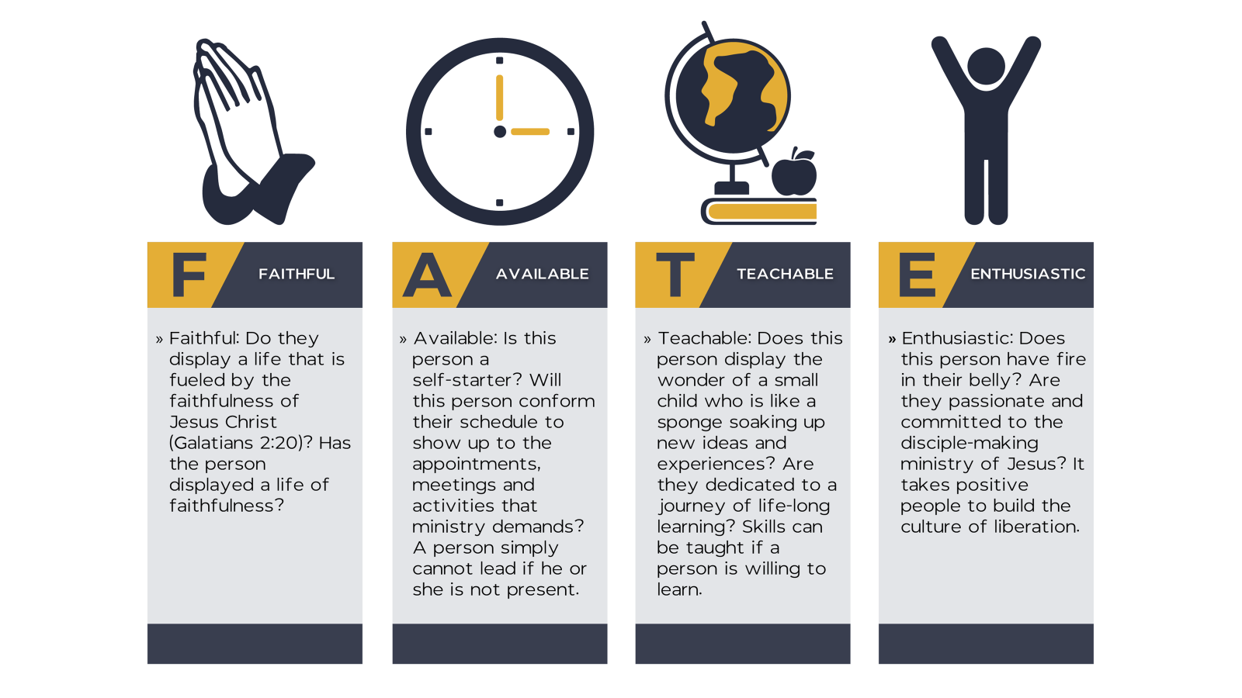

Slide 9
REFLECT
What spaces of belonging are engaged locally?
What are these spaces multiplying?
What one change in spaces of belonging would bring discipleship towards the center of ministry rhythms?
What would it look like to begin a discipleship core?

Slide 10
NEXT STEPS
Review your annual church calendar and MAP for insights related to four spaces of belonging.
Identify one goal related to implementation of your renewed discipleship pathway.
Outline goal in annual MAP.

Slide 11
How to Prepare
Read chapters 10-12
Bring annual church calendar
Bring refined discipleship pathway

